Slide 1
PERFECT CAREERS- MATCHES YOUR SKILLSETS WITH YOUR JOB PROFILE
TEAM: YUVARAJ GANESH
AKANKSHA CHATRA

Slide 2
CONTENTS
MOTIVATION
PROPOSED IDEA
DATASET SUMMARY
RESULTS
FUTURE WORK

Slide 3

MOTIVATION

Slide 4
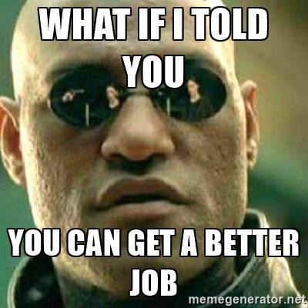
PROPOSED IDEA

Slide 5
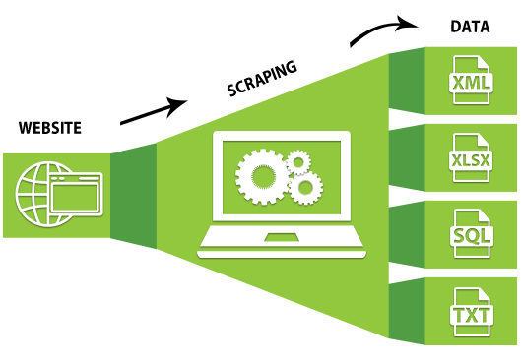

DATA SCRAPING
MACHINE LEARNING

Slide 6
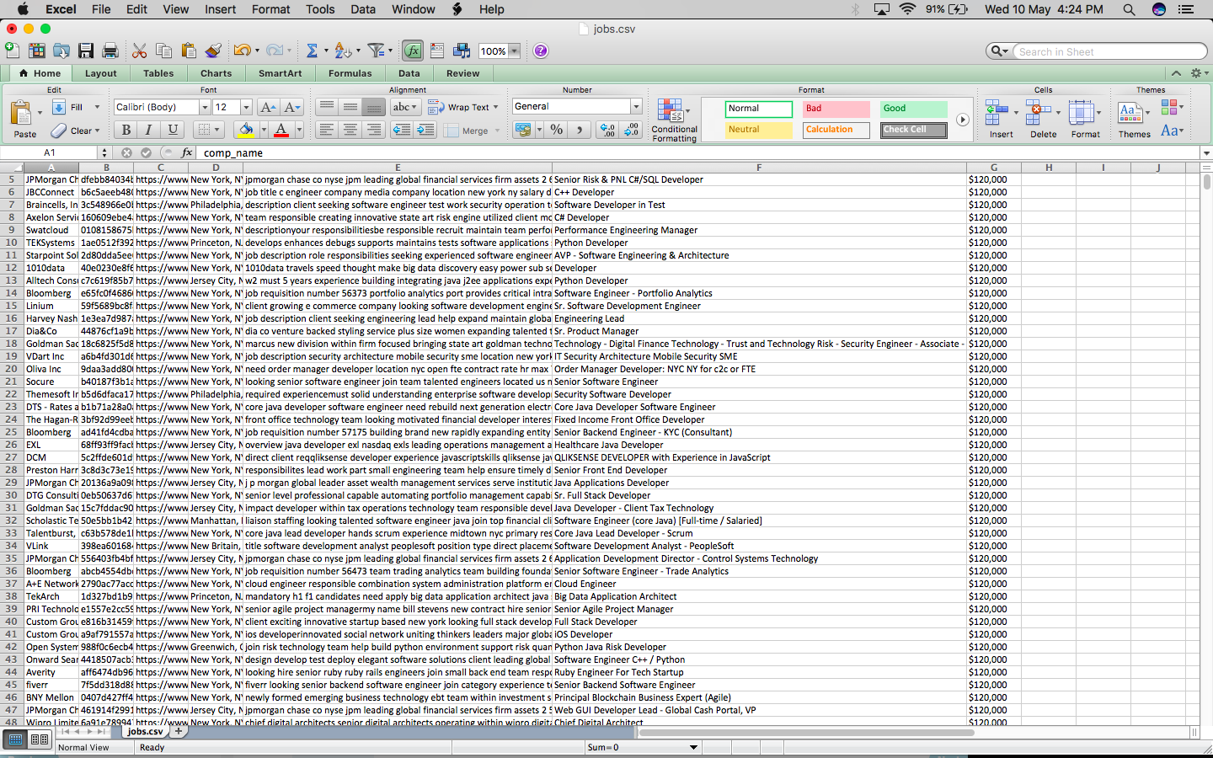
DATASET SUMMARY

Slide 7
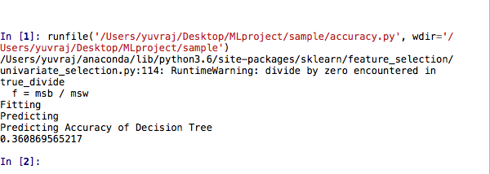
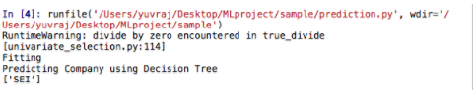
RESULTS
ACCURACY (DECISION TREE)
PREDICTION (DECISION TREE)

Slide 8
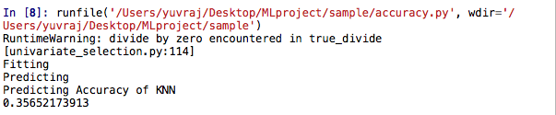
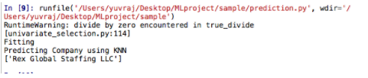
ACCURACY (KNN)
PREDICTION (KNN)

Slide 9
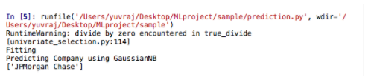
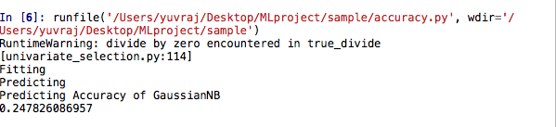
ACCURACY (GAUSSIAN)
PREDICTION (GAUSSIAN)

Slide 10
FUTURE WORK
Improving accuracy
Focusing more on cleaning the unstructured data

Slide 11
THANK YOU

